Slide 1




Data Communication Concepts
How to Start Using Packet Tracer Simulation

Slide 2
Outline
Outline
Overview
What is Packet Tracer
Organization of Packet Tracer
Interface
Sample Network Simulation

Slide 3
Overview
Outline
In this lab, we will learn how to use a packet tracer network simulation .

Slide 4
Outline
What is Packet Tracer
Packet Tracer is a program used to illustrate at a basic level how networks work.

Slide 5
Outline
Organization of Packet Tracer
Packet Tracer has two different views
– Logical Workspace
– Physical Workspace
Packet Tracer also has two modes of operation
– Realtime Mode
– Simulation Mode

Slide 6
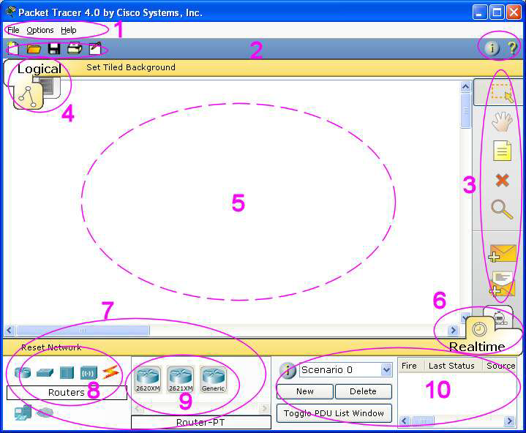
Interface
Outline

Slide 7
Outline
Interface (Continue…)
The areas show on the screenshot are:
Menu Bar - 1
This bar provides the File, Options, and Help menus.
You will find basic commands such as Open, Save, Print, and Preferences in these menus.
You will also be able to access the Activity Wizard from the File menu .

Slide 8
Outline
Interface (Continue…)
Main Tool Bar - 2
• This bar provides shortcut icons to the File menu commands, including the Activity Wizard.
On the right, you will also find the Network Information button, which you can use to enter a description for the current network or any text you wish to include.

Slide 9
Outline
Interface (Continue…)
Common Tools Bar - 3
• This bar provides access to these commonly used. workspace tools:
– Select
– Move Layout
– Place Note
– Delete
– Inspect
– Add Simple PDU
– Add Complex PDU

Slide 10
Outline
Interface (Continue…)
Workspace Type Bar - 4
• You can toggle between the Physical Workspace and the Logical Workspace with the tabs on this bar.
Workspace - 5
• This area is where you will create your network, watch simulations, and view many kinds of information and statistics.

Slide 11
Interface (Continue…)
Outline
Real-time or Simulation Bar - 6
• You can toggle between Real-time Mode and Simulation Mode with the tabs on this bar.
Network Component Box - 7
• This box is where you choose devices and connections to put onto the workspace.
• It contains the Device-Type Selection Box and the Device-Specific Selection Box.

Slide 12
Interface (Continue…)
Outline
Device Type Selection Box - 8
• This box contains the type of devices and connections available in Packet Tracer.
• The Device-Specific Selection Box will change depending on which type of devices you clicked.
Device Selection Box - 9
• This box is where you choose specifically which devices you want to put in your network and which connections to make.
Created Packet Window -10
• This window manages the packets you put in the network during simulation scenarios.

Slide 13
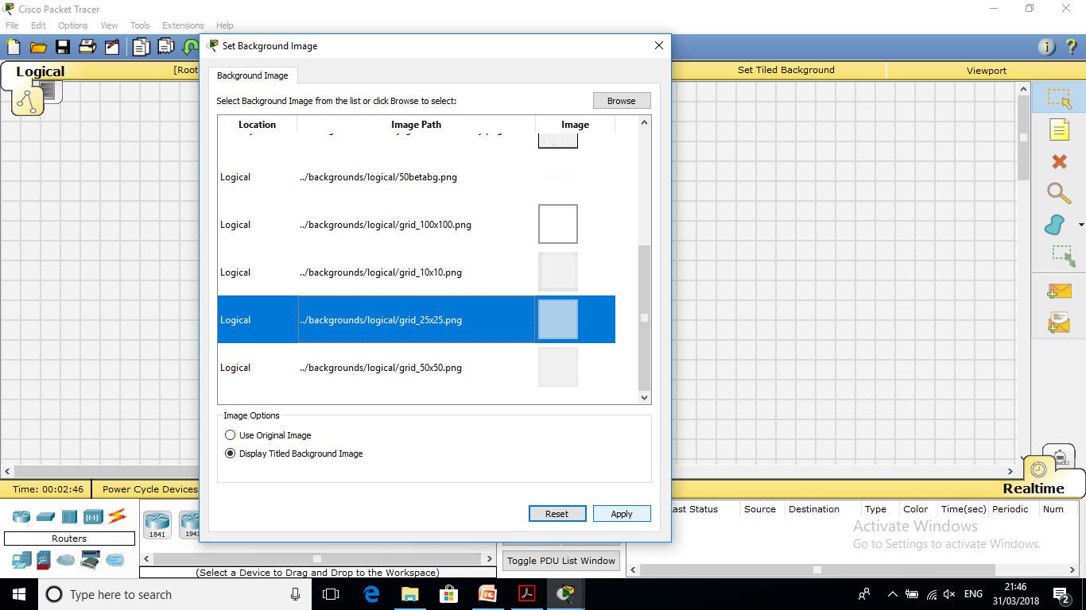
Outline
Sample Network Simulation
Start creating your network by loading a background grid using the Set Tiled Background button and Select for example, the grid_25x25.png.

Slide 14
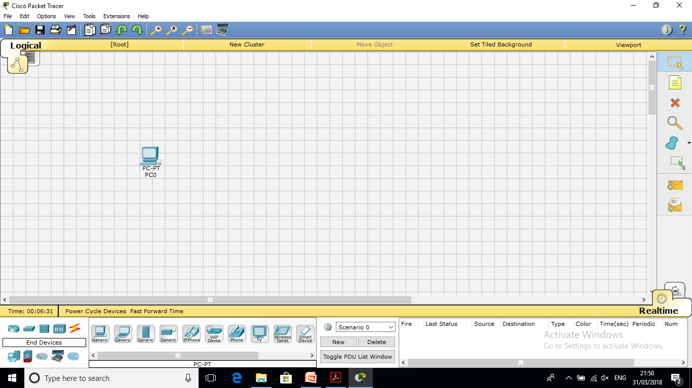
Outline
Sample Network Simulation (Continue…)
Select the Generic PC under End Devices and drag it as the first PC onto the workspace.

Slide 15
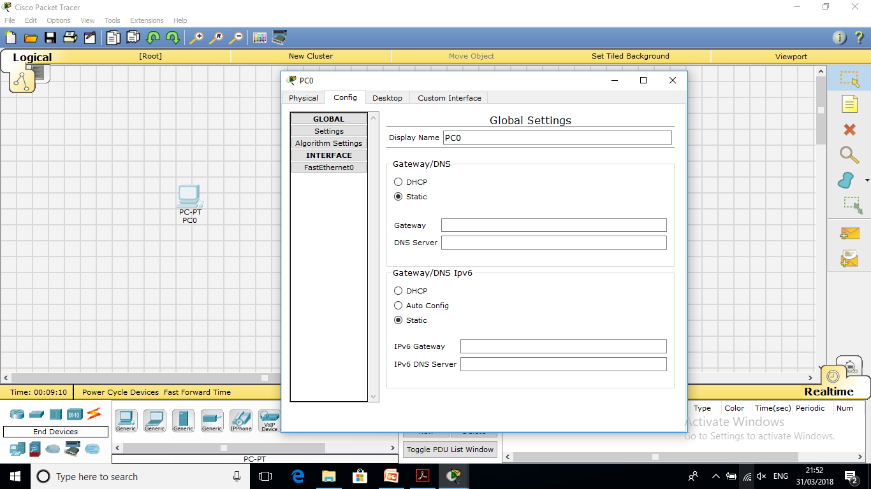
Outline
Sample Network Simulation (Continue…)
Open the PC's configuration window and change its settings by going to the Config Tab.

Slide 16
Outline
Sample Network Simulation (Continue…)
Change the PC's name to Tokyo and under Interface, click on FastEthernet and set the IP address as 192.168.1.1
It will assume other settings for you.
Make sure that the Port Status is on.
Note for future reference that you could modify other Ethernet interface
settings, such as bandwidth, duplex, MAC address, and subnet mask in this window.

Slide 17
Outline
Sample Network Simulation (Continue…)
Drag another PC to the workspace, name it Paris and set its IP address as 192.168.1.2
Make sure that the Port Status is on.
Under Connections, select the Copper Straight-through cable, the solid black line, and make a connection between the devices with it.
The red lights on the link indicate that the connection is not working.
The point is the simulator will do what you tell it, whether that is right or wrong.
Now, using the Delete tool, remove the Copper Straight-through cable, and use a Copper Cross-over cable instead.

Slide 18
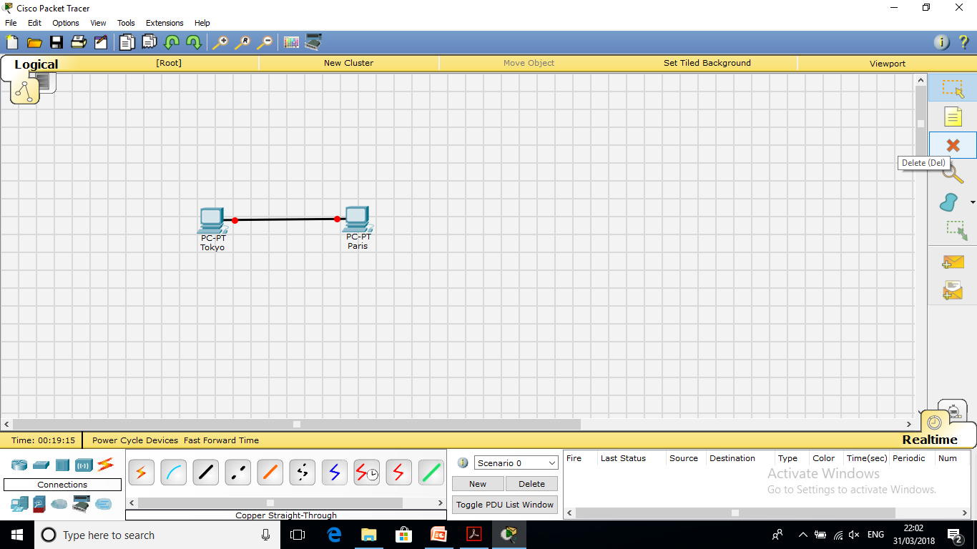
Outline
Sample Network Simulation (Continue…)

Slide 19

Outline
Sample Network Simulation (Continue…)
The lights should turn green at this point, and if you mouse over or hover over either PC, you'll see the link status indicated as up.

Slide 20
Outline
Sample Network Simulation (Continue…)
Single click on the Tokyo PC and turn the PC on and off and on again, while paying attention to the link lights.
Do the same step for the Paris PC.
Turning devices off will result in red link lights meaning that the link is down.
Save your work by using the File -> Save
As option.

Slide 21
Outline
Sample Network Simulation (Continue…)
Start with your original saved file open.
Notice you are in Realtime Mode.
Use the Add Simple PDU tool to send a simple 1-time ping message called an echo request, to the other PC, which responds with an echo reply because you have properly configured their IP address settings.

Slide 22
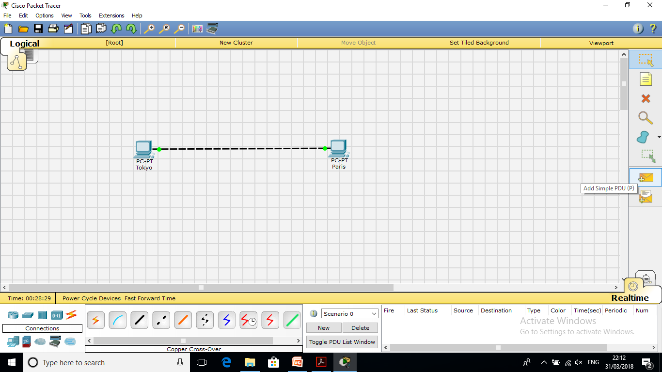
Outline
Sample Network Simulation (Continue…)

Slide 23
Outline
Sample Network Simulation (Continue…)
To use the Add Simple PDU tool
– Click on it
– Click on the first PC
– Click on the second PC
Then look down in the bottom right corner to see if the ping was successful.

Slide 24

Outline
Sample Network Simulation (Continue…)

Slide 25
Outline
Sample Network Simulation (Continue…)
Another way to check the connectivity between the two PCs through ping command???

Slide 26


THANK YOU

